Slide 1
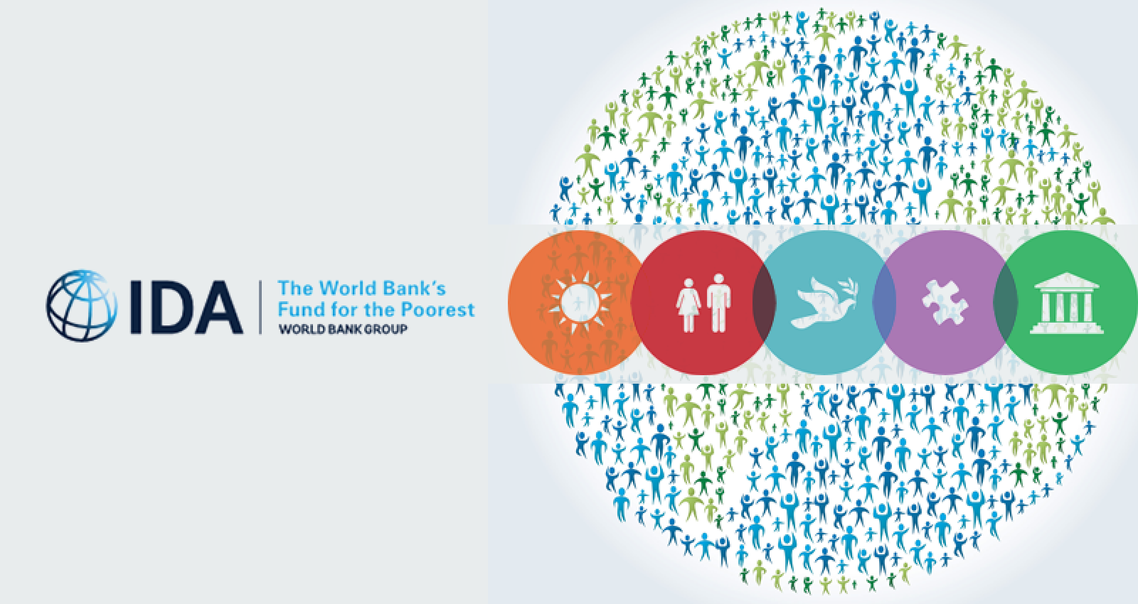
Analysis of the Credits and Grants of The International Development Association (IDA)
Vamshi Krushna Lakavath
015351310
Department of Applied Data Science
San Jose State University
Major Professor: Andrew H. Bond

Slide 2
Overview
The International Development Association (IDA). IDA was established on 8th November 1960.
IDA is an affiliate and complementary institution of the World Bank.
The idea to establish this institution was to provide loans and grants to the under developed and developing countries on more liberal or concessional terms than those applied by the World Bank.
Due to this IDA is sometimes called the “Soft Loan Window” of the World Bank.
Its main objectives are Provision of financial assistance to the less developed member countries on easy terms and Promoting economic development, increase in productivity and consequent improvement in the living standards in the less developed areas of the world.
The dataset has data from 1961 to 2021 that contains details of all countries. The dataset has 30 fields and 982,989 rows. Each row represents a credit or grant.
The data will be updated regularly by IDA. The data can be directly connected to the tableau using OData as a streaming data source.
https://finances.worldbank.org/Loans-and-Credits/IDA-Statement-Of-Credits-and-Grants-Historical-Dat/tdwh-3krx/data
https://finances.worldbank.org/api/odata/v4/tdwh-3krx

Slide 3
Fields of the Dataset
The dataset consists of the following fields:
End of Period: End of Period Date represents the date as of which balances are shown in the report.
Credit Number: This is the loan number for each loan or grant provided by the IDA. There are 9574 unique credit numbers in the dataset that means a total of 9574 credits and grants provided by the IDA as of October 19, 2021.
Region: World Bank Region to which the country and loan belong. There are a total 9 regions in the dataset.
Country Code: It indicates the code of the participant country. Total 128 unique country codes are there in the data.
Country: The name of the country. There are 132 unique values in this field that covers some of the countries and regions in the world.
Borrower: The representative of the borrower to which the Bank loan is made.
Credit Status: Status of the loan.
Service Charge Rate: Current Interest rate or service charge applied to loan.
Currency of Commitment: The currency in which a borrower’s loan, credit or grant is denominated.
Project ID: A Bank project is referenced by a project ID. One Project ID can be associated with more than one loan, credit, or grant.

Slide 4
Fields of the Dataset
Project Name: A Short description of the project name.
Original Principal Amount: The original US dollar amount of the loan that is committed and approved.
Canceled Amount: The portion of the undisbursed balance that has been canceled.
Undisbursed Amount: The amount of a loan commitment that is still available to be drawn down.
Disbursed Amount: The amount that has been disbursed from a loan commitment in equivalent US dollars.
Repaid to IDA: Total principal amounts repaid to IDA in US dollars.
Due to IDA: Amount due and outstanding as of the End of Period date.
Exchange Adjustment: The increase (decrease) in value of disbursed and outstanding amount due to exchange rate fluctuations.
Borrower's Obligation: The Borrower Obligation is the outstanding balance for the loan as of the end of period date in US dollars equivalent.
Sold 3rd Party: Portion of loan sold to a third party.
Repaid 3rd Party: Amount repaid to a third party.
Due 3rd Party: Amount due to a third party.
Credits held: The sum of the disbursed and outstanding amounts (net of repayments, i.e. Due to IBRD/IDA) plus undisbursed available amounts.

Slide 5
Fields of the Dataset
First Repayment Date: The date on which principal repayment starts.
Last Repayment Date: The date specified in the loan/credit agreement (amended for any partial prepayments) on which the last principal installment must be repaid by the Borrower.
Agreement Signing Date: The date the borrower and the Bank sign the loan agreement.
Board Approval Date: The date the World Bank approves the loan.
Effective Date: The date on which a legal agreement becomes effective, or is expected to become effective.
Close Date (Most Recent): The date specified in the legal agreement (or extension) after which the Bank may, by notice to the borrower, terminate the right to make withdrawals from the loan account.

Slide 6

Data Preparation
Data preparation has been done using the tableau prep builder.
Geographical role for country field has been changed to country/region.
Geographical role for country code field has been changed to country/region.
The date time field has been changed to date, because time is same in all the records. I.e 12:00:00
Exchange adjustment is removed because it has only zeros and nulls.
Due 3rd party removed because it has only zeros and nulls.
And calculated several fields for analysis

Slide 7
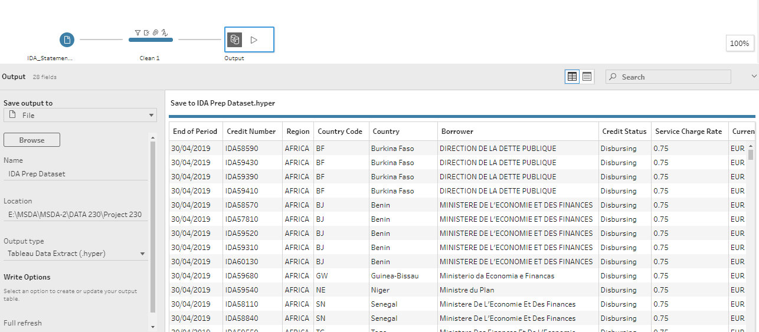
Data Preparation

Slide 8
Some of the visualizations I would like to do for this project are
I. Total number loans availed by individual countries.
II. Total loans and sum of principal amount sanctioned to each country.
III. Total credits and grants provided by IDA till today
IV. Credit status of each loan and original principal amount sanctioned.
V. Trend of credit approvals by IDA board
VI. Average service charges charged by the IDA for its loans to different countries.
VII. How many times on an average a project was funded by IDA to a country.
VIII. What is the average cancellation rate for different countries?

Slide 9
Some of the visualizations I would like to do for this project are
IX. Rate of disbursement out of sanctioned amount.
X. Average term of a loan.
XI. Most benefited region.
XII. Most benefited countries.

Slide 10
Visualizations on Tableau

Slide 11
Conclusion
I have used several User Interface tools (UI) for data preparation and Visualization.
IDA provided interest free loans for the projects to the underdeveloped countries to develop their Education, Health Care, Transportation, Services, Import and Export, and many other sectors.
It is a primary financial support for many countries in the African region, It is extremely dedicated and helpful in developing the Underdeveloped countries.
There are thousands of Projects funded by the IDA across 125 countries in the World and Billions of people have benefited from IDA.

